Slide 1
Together, We Can Stop HPV Cancers
Current Issues in Immunizations NetConferences
November 19, 2014
Jill B Roark, MPH
Lead, Adolescent Immunization Communications
Health Communication Science Office
National Center for Immunization and Respiratory Diseases
Centers for Disease Control and Prevention

Slide 2
Learning Objectives
Describe an emerging immunization issue.
List a recent immunization recommendation made by the Advisory Committee on Immunization Practices.
Locate resources relevant to current immunization practice.
Obtain, assess and apply patient information to determine the need for immunization.

Slide 3
Presentation Goals
Describe the importance of HPV vaccination rate improvement.
List ways to accelerate HPV vaccine uptake in the United States.
Provide useful and compelling information about HPV vaccine that can be shared to aid parents in making the decision to vaccinate their children.
Locate resources relevant to HPV vaccine communications.

Slide 4
Continuing Education
CE credit is available only through the CDC/ATSDR Training and Continuing Education Online system at http://www2a.cdc.gov/TCEOnline/
CE credit expires on
December 22, 2014

Slide 5
Disclosure Statements
CDC, our planners, and our presenters wish to disclose they have no financial interests or other relationships with the manufacturers of commercial products, suppliers of commercial services, or commercial supporters.

Slide 6
Disclosure Statements
Presentations will not include any discussion of the unlabeled use of a product or a product under investigational use with the exception of Ms. Roark’s discussion of HPV vaccines. Ms. Roark will be discussing use of HPV vaccines in a manner recommended by the Advisory Committee on Immunization Practices, but not approved by the Food and Drug Administration.
CDC does not accept any commercial support.

Slide 7
HPV Infection & Disease
Understanding the Burden
Notes:
The first section will focus on HPV infection and disease prevalence.

Slide 8
HPV Infection is Common
An estimated 79 million Americans are currently infected
14 million new infections each year in the United States
Intercourse not necessary for transmission

Slide 9
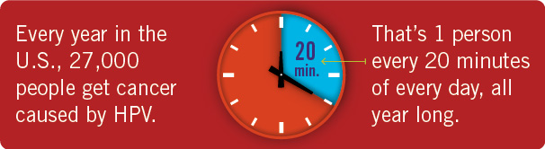
Persistant HPV Infection
Can Cause Cancer
Notes:
Human papillomavirus (HPV) infection is very common, but usually goes away on its own. However sometimes the infection can persist and lead to changes in the cells that can cause cancer. Nearly 18,000 women in the United States are diagnosed with a cancer caused by HPV each year. There are more than 9,000 HPV cancers diagnosed in U.S. men each year.

Slide 10
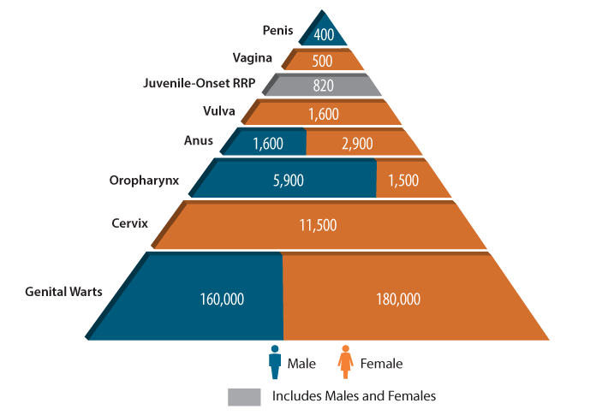
Numbers of Cancers and Genital Warts Attributed to HPV Infections, U.S.
CDC. Human papillomavirus (HPV)-associated cancers. Atlanta, GA: US Department of Health and Human Services, CDC; 2013. Available at http://www.cdc.gov/cancer/hpv/statistics/cases.htm
Notes:
Recent U.S. population-based studies conducted by CDC show that 66% of cervical cancers, 55% of vaginal cancers, 79% of anal cancers, and 62% of oropharyngeal cancers are attributable to HPV types 16 or 18. Each year in the United States, an estimated 26,000 new cancers are attributable to HPV, about 17,000 in women and 9,000 in men
CDC. Human papillomavirus (HPV)-associated cancers. Atlanta, GA: US Department of Health and Human Services, CDC; 2013. Available at http://www.cdc.gov/cancer/hpv/statistics/cases.htm.

Slide 11
Cancers caused by HPV
Penis
n=700
8%
Vagina
n=600
3%
Vulva
n=2,200
13%
Anus
n=2,600
15%
Anus
n=1,400
15%
Oropharynx
n=1,800
10%
Cervix
n=10,400
59%
Oropharynx
n=7,200
77%
Women (n = 17,600)
Men (n = 9,300)
CDC, United States Cancer Statistics (USCS), 2006-2010
Notes:
Persistant HPV infection can cause cancer in both men and women. Most of the cancers caused by HPV in women are cancers of the cervix, which is the opening to the uterus. Pap tests are used to screen women for cervical cancer and precancer, but even with an excellent cervical cancer screening program in the United States, between 10,000 and 11,000 women get cervical cancer each year in our country.
In men, the most common cancer caused by persistant HPV infection, is oropharyngeal cancer. The oropharynx is area that includes the back of the throat, base of the tongue, and the base of the tonsils.

Slide 12
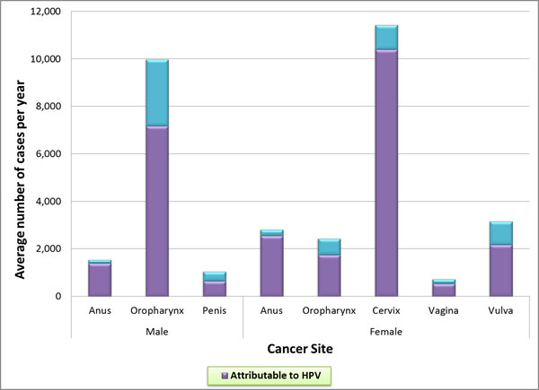
How Many Cancers Are Linked with HPV Each Year?

Slide 13
Annual Report to the Nation on the Status of Cancer: HPV-Associated Cancers
From 2000 to 2009, oral cancer rates increased
  4.9% for Native American men
  3.9% for white men
  1.7% for white women
  1% for Asian men
Anal cancer rates doubled from 1975 to 2009
Vulvar cancer rates rose for white and African-American women
Penile cancer rates increased among Asian men
Jemal A et al. J Natl Cancer Inst 2013;105:175-201
Notes:
All types of HPV cancers are on the rise, some disproportionately affecting different racial/ethnic minorities

Slide 14
Cervical Cancer
Cervical cancer is the most common HPV-associated cancer among women
  500,000+ new cases and 275,000 attributable deaths world-wide in 2008
  11,000+ new cases and 4,000 attributable deaths in 2011 in the U.S.
  37% cervical cancers occur in women who are between the ages of 20 and 44
  13% (or nearly 1 in 8) between 20 and 34
  24% ( or nearly 1 in 4) between 35 and 44
CDC. HPV–associated cancers—US, 2004–2008. MMWR 2012;61(15):258–261.
Cervical Cancer Counts by Age. US Cancer Statistics data from 2010, CDC.gov.
Notes:
Cervical cancer was once the leading cause of cancer death for women in the United States. Now it is the most preventable of all of the female cancers. The Pap test has helped decrease the number of women in the U.S. with cervical cancer by about 75% in the past 50 years. However even with an excellent cervical cancer screening program in the U.S., there are still over 11,000 cases of cervical cancer each year in this country.
Many people think of gynecological cancers as just affecting older women, but cervical cancer affects 1 in 3 women who are of reproductive age

Slide 15
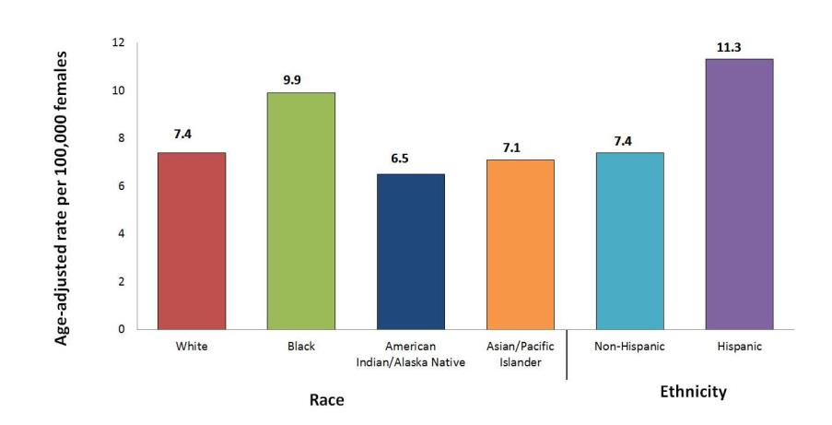
HPV-Associated Cervical Cancer Rates by Race and Ethnicity, United States, 2004–2008
Watson et al. Human papillomavirus-associated cancers—United States, 2004-2008. MMWR 2012;61:258-261.
Notes:
Cervical cancer affects women of color and their communities more than their white counterparts. Women of color are often diagnosed with cervical cancer at a later stage than white women. Black women are more likely to die from cervical cancer than women of other races or ethnicities, possibly because of decreased access to Pap testing or follow-up treatment.
Hispanic women have the highest rates of cervical cancer in the United States. For example, for every 100,000 women living in the U.S., about 11 Hispanic women are diagnosed with cervical cancer, compared to only seven non-Hispanic women.

Slide 16
Preventing Cancer is Better Than Treating Cancer
4,000 cervical cancer deaths
10,846 cases of cervical cancer
330,000 new cases of high-grade
precancer of the cervix
1 million new cases of genital warts
1.4 million new cases of
low grade cervical precancer
For U.S. Women this equals 3 million cases and $7 billion
American Cancer Society. 2008; Schiffman Arch Pathol Lab Med. 2003; Koshiol
Sex Transm Dis. 2004; Insinga, Pharmacoeconomics, 2005
Notes:
Without protection from HPV infections, 3 million women each year are affected by the diseases caused by persistant HPV infection.
One in three cervical cancers are diagnosed in women who are between the ages of 20 and 44 years. Cervical cancer is often treated with radiation, chemotherapy, and/or hysterectomy, all of which can leave younger women unable to have children.
High grade, or severe, precancers of the cervix require biopsies and treatment.
Genital warts are often frozen or burned off.
Low grade, or less severe, precancers of the cervix require biopsies.

Slide 17
HPV Vaccine
Evidence-Based HPV Prevention
Notes:
This next section will focus on HPV vaccine.

Slide 18

HPV Vaccine
is
CANCER
Prevention

Slide 19
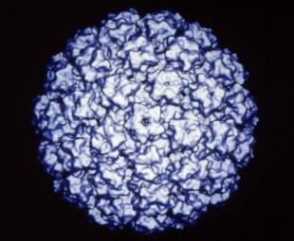
HPV Prophylactic Vaccines
Recombinant L1 capsid proteins that form
“virus-like” particles (VLP)
Non-infectious and
non-oncogenic
Produce higher levels of neutralizing antibody than natural infection
HPV Virus-Like Particle
Notes:
HPV vaccines are made from virus-like particles that cannot cause infection with HPV or cause cancer. HPV vaccines produce a better immune response than an HPV infection.

Slide 20
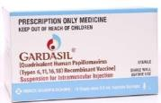
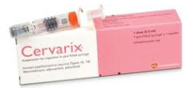
HPV Vaccine
Quadrivalent/HPV4 (Gardasil) | Name | Bivalent/HPV2 (Cervarix)
Merck | Manufacturer | GlaxoSmithKline
6, 11, 16, 18 | Types | 16, 18
Females: Anal, cervical, vaginal and vulvar precancer and cancer; Genital warts Males: Anal precancer and cancer; Genital warts | Indications | Females: Cervical precancer and cancer Males: Not approved for use in males
Hypersensitivity to yeast | Contraindications | Hypersensitivity to latex (latex only contained in pre-filled syringes, not single-dose vials)
3 dose series: 0, 2, 6 months | Schedule (IM) | 3 dose series: 0, 1, 6 months
Notes:
There are two brands of HPV vaccine on the market. This slide was developed at the request of healthcare providers who wanted to see a side-by-side comparison of the two vaccines.
No clinical trial data are currently available to demonstrate efficacy for prevention of oropharyngeal or penile cancers. However, because many of these are attributable to HPV16, the HPV vaccine is likely to offer protection against these cancers as well.

Slide 21
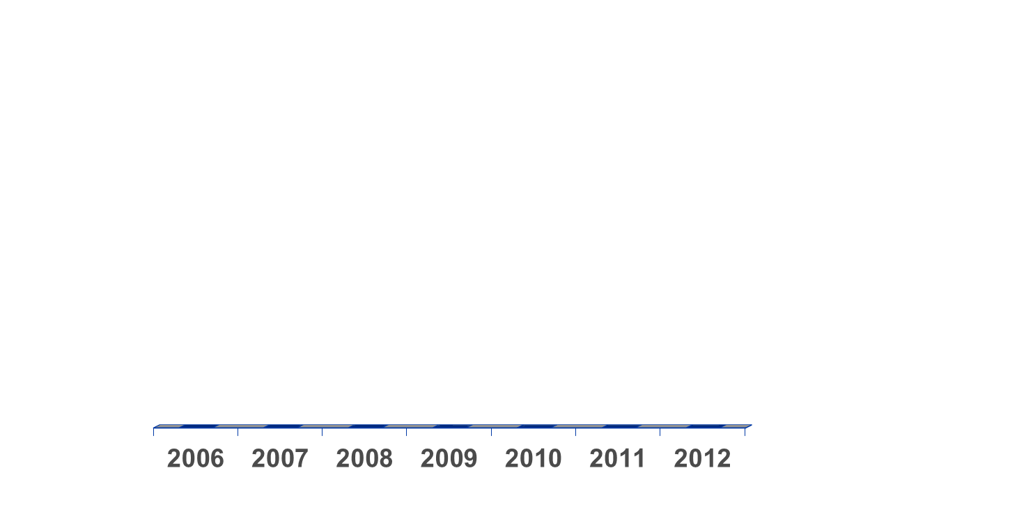
Evolution of recommendations for
HPV vaccination in the United States
Quadrivalent
Routine, females 11 or 12 yrs*
and 13-26 yrs not previously vaccinated
Quadrivalent or Bivalent
Routine, females 11 or 12 yrs*
and 13-26 yrs not previously vaccinated
Quadrivalent
May be given,
males 9-26 yrs*
Quadrivalent
Routine, males 11 or 12 yrs*
and 13-21 yrs not previously vaccinated
May be given, 22-26 yrs**
June
October
Quadrivalent (HPV 6,11,16,18) vaccine; Bivalent (HPV 16,18) vaccine
Can be given starting at 9 years of age;
** For MSM and immunocompromised males, quadrivalent HPV vaccine through 26 years of age
Notes:
This slide shows the evolution of HPV vaccine recommendations in the US.

Slide 22


HPV Vaccine Recommendations
Girls & Boys can start HPV vaccination at age 9
Preteens should finish HPV vaccine series by age 13
Plus girls 13-26 years old who haven’t started or finished HPV vaccine series
Plus boys 13-21 years old who haven’t started or finished HPV vaccine series

Slide 23
HPV Vaccination Schedule
ACIP Recommended schedule is 0, 1-2*, 6 months
  Following the recommended schedule is preferred
  0, 6 weeks, 6 months may help parents remember
Minimum intervals
  4 weeks between doses 1 and 2
  12 weeks between doses 2 and 3
  24 weeks between doses 1 and 3
Administer IM
CDC. Quadrivalent Human Papillomavirus Vaccine: Recommendations of ACIP. MMWR 2007;56(RR02):1-24.
Notes:
ACIP recommended schedule for the 3-dose series is 0, 1 to 2 months and 6 months for either vaccine.
(The FDA-approved schedule for HPV4 is 3 doses at 0, 2, and 6 months. The schedule is slightly different for HPV2- 3 doses at 0 , ONE and 6 months. ACIP reconciled this difference by recommending a schedule of 0, 1 to 2 months, and 6 months for either vaccine. )
The minimum intervals for both vaccines are 4 weeks between the first and second doses, 12 weeks between the second and third doses, and 24 weeks between the first and third doses. However, minimum intervals between doses should NOT be used for routine HPV vaccination. There are almost no situations where a compressed or accelerated schedule is needed.
Remember that the series can be started as early as 9 years of age.

Slide 24
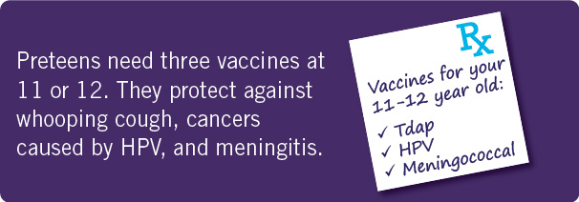
HPV Vaccine Should be Given with the Other Preteen Vaccines

Slide 25
HPV Vaccine Is Safe, Effective, and Provides Lasting Protection
HPV Vaccine is SAFE
  No serious sides effects cause by HPV vaccine
  HPV vaccine safety similar to menigococcal and Tdap vaccine safety
HPV Vaccine WORKS
  High grade cervical precancer has declined in Australia
  Prevalence of HPV infection declined by 56% in U.S.
HPV Vaccine LASTS
  No evidence of waning immunity for at least 10 years

Slide 26
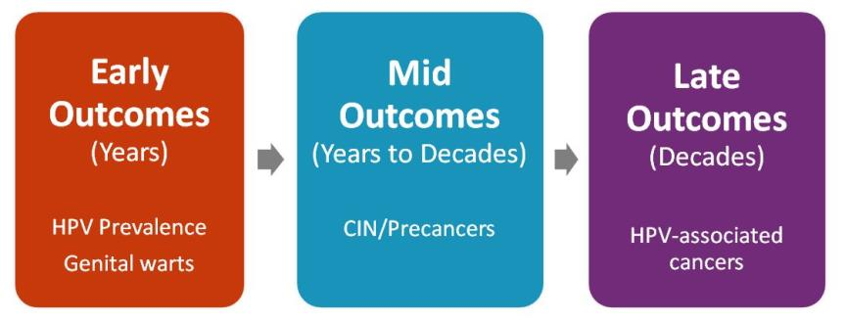
Monitoring Impact of HPV Vaccine Programs: HPV-associated Outcomes
Notes:
Post-licensure monitoring is important to evaluate the real-world impact of vaccination on populations, and a variety of activities are underway to assess HPV vaccine impact on early, mid-, and late outcomes. Reduction in vaccine type HPV provides early evidence of impact on infection, and reduction in anogenital warts is the first disease to be impacted by the quadrivalent HPV vaccine. Cervical lesions that are detected through routine screening can be used as mid outcomes, and late outcomes include all HPV-associated cancers.

Slide 27
Prevalence of HPV 6, 11,16, 18* in Cervicovaginal Swabs, by Age Group, NHANES, 2003-2006 and 2007-2010, U.S.
56% decline
*weighted prevalence
Markowitz, et al. Reduction in HPV prevalence among young women following HPV vaccine introduction in the United States, NHANES, 2003-2010. J Infect Dis 2013
27

Slide 28
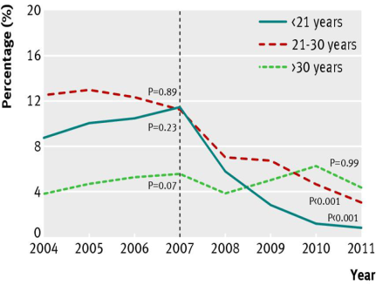
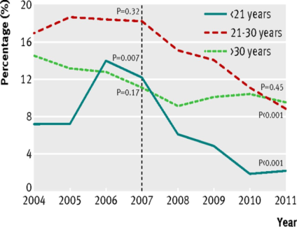
Impact of HPV vaccination in Australia
Proportion of Australian born females and males diagnosed as having genital warts at first visit, by age group, 2004-11
Females
Males
Ali, et al., Genital warts in young Australians five years into national human papillomavirus vaccination programme: national surveillance data. British Med J 2013;346:f2032
28
Notes:
Australia has high HPV vaccine coverage and has seen declines prevalence of HPV infections, pre-cancerous lesions, and genital warts in young women. HPV vaccine was only recommended for girls in Australia until 2012, yet they have seen a decline in genital warts in young men, which shows that there has been a decrease in transmission of HPV.

Slide 29
HPV Vaccine
Duration of Immunity
Studies suggest that vaccine protection is long-lasting; no evidence of waning immunity
  Available evidence indicates protection for at least 8-10 years
  Multiple cohort studies are in progress to monitor the duration of immunity
Romanowski B. Long term protection against cervical infection with the human papillomavirus: review of currently available vaccines. Hum Vaccin. 2011 Feb;7(2):161-9.
Notes:
A question we are asked often is, “how long will the protection provided by the HPV vaccine last?” Studies suggest that vaccine protection is long-lasting.
In 2010, a review of HPV vaccines was conducted regarding the long-term protection against cervical infection with the human papillomavirus. At that time the vaccines were shown to provide protection against persistent cervical HPV 16/18 infections for up to 8 years, which was the maximum time of research follow-up at that point. More will be known about the total duration of protection as research continues but at this time there is no evidence of waning immunity such has been seen with the meningococcal conjugate vaccine which now requires a second dose.
This information will be updated as additional data regarding duration of protection become available.
Romanowski B. Long term protection against cervical infection with the human papillomavirus: review of currently available vaccines. Hum Vaccin. 2011 Feb;7(2):161-9.

Slide 30
HPV Vaccination is best at 11 or 12
HPV vaccine works best when the entire series has been given before exposure to HPV
  Very little exposure to HPV at 11 and 12 years of age
  1/3 of 9th graders and 2/3 of 12th graders have engaged in sexual intercourse
  24% of high school seniors have had sexual intercourse with four or more partners
Higher immune response from HPV vaccine in preteens than in older teens

Slide 31
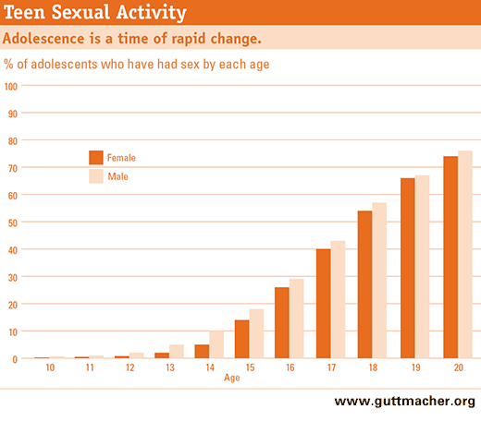
Rationale for vaccinating early:
Protection prior to exposure to HPV
Notes:
HPV vaccines should be given prior to exposure to HPV. There is no reason to wait until a teen is having sex. We don’t wait until exposure occurs to give any other routinely recommended vaccine- we give the vaccine before we think exposure is likely to occur to ensure the best protection.

Slide 32
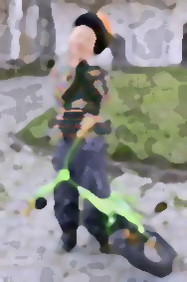

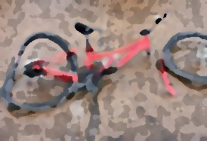
When should the bike helmet go on?
A B C
Notes:
Most people are familiar with, and endorse the use of bicycle helmets.
When do you want your children to put on their bike helmets?
Before they get on their bike
When they are riding their bike in the street
When they see the car heading directly at them
After the car hits them

Slide 33
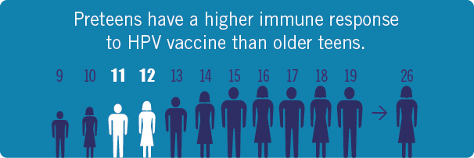
HPV Vaccine is Best at Ages 11 or 12 Years
While there is very little risk of exposure to HPV before age 13, the risk of exposure increase thereafter.

Slide 34
HPV Vaccine coverage
Notes:
This next section will focus on HPV vaccine coverage.

Slide 35
Adolescent Vaccination Coverage
United States, 2006-2013
MMWR 2014; 63(29);625-633.
Notes:
The strong coverage rates for Tdap vaccine demonstrate that not only are most preteens and teens getting to the doctor, but they are also getting at least one of the recommended adolescent vaccines.

Slide 36
Impact of Eliminating Missed Opportunities in Girls 13-17 Years in the United States
Among girls unvaccinated for HPV, 84% had a missed opportunity
Missed opportunity: Healthcare encounter when some, but not all ACIP-recommended vaccines are given.
HPV-1: Receipt of at least one dose of HPV.
Stokley S, Curtis R, Jeyarajah J. Human Papillomavirus Vaccination Coverage Among Adolescent Girls, 2007-2012, and Postlicensure Vaccine Safety Monitoring, 2006-2013 - United States. MMWR. 62(29);591-595.
Notes:
A missed opportunity is defined as a healthcare encounter when some, but not all ACIP-recommended vaccines are given. For girls eligible to receive HPV vaccine, 84% saw a healthcare provider and received a vaccine but not HPV vaccine. If all of those girls had received HPV vaccine, coverage for HPV vaccination of 13-17 years would have been 93% in 2012.
High HPV vaccination coverage with existing infrastructure and health-care utilization is possible in the United States. Taking advantage of every health-care encounter, including acute-care visits, to assess every adolescent’s vaccination status can help minimize missed opportunities. Potential strategies
include using vaccination prompts available through electronic health records or checking local and state immunization information systems to assess vaccination needs at every encounter. Series completion also can be promoted through scheduling appointments for second and third doses before patients leave providers’ offices after receipt of their first HPV vaccine doses and with automated reminder-recall systems.

Slide 37
Impact of Eliminating Missed Opportunities in Girls 13-17 Years of Age, Nebraska
Missed opportunity: Health care encounter on or after 11th birthday, and on or after March 23, 2007 during which ≥ 1 vaccine was administered but not the 1st dose of the HPV vaccine series
HPV-1: Receipt of at least one dose of HPV
* 95% Confidence interval (CI) width > 20. Estimates with 95% CI widths >20 might not be reliable

Slide 38
HPV Vaccine Will Save Lives
26 million:
168,400:
54,100:
number of girls under 13 years of age in the United States
number who will develop cancer if none are vaccinated
number who will die from cervical cancer if none are vaccinated
Adapted from Chesson HW et al, Vaccine 2011;29:8443-50

Slide 39
More Young People Need To Get HPV Vaccine To Protect Them From Cancer
For each year we only vaccinate 30% of young people against HPV infection instead of 80%...
4,400:
1,400:
number of future cervical cases we will NOT prevent each year
number of cervical cancer deaths we will NOT prevent each year

Slide 40
How We Improve HPV Vaccination Rates?
Some things we need to consider:
Initiation vs. completion predictors differ
Provider “hesitancy” (weak recommendations)
  Potential factors: risk assessment, resistant to 11-12 yr rec, cost, competing priorities, communication skills
Parental attitudes likely amenable to provider communication if clinicians are convinced & confident
System interventions depend on clinician commitment
  E.g., Missed opportunities, AFIX, HEDIS (positive feedback loops) require clinicians to buy-in to purpose & targets

Slide 41

President’s Cancer Panel Report
Develop a finite set of actionable recommendations that focus on effective and/or promising strategies to increase uptake of HPV vaccines in the United States among age-eligible males and females.
Identify evidence about effective and/or promising strategies to increase vaccine use and lessons learned from HPV vaccine use in the United States and elsewhere.
Identify topics and issues for which there are knowledge gaps that require further study.
Identify practice and application issues that require attention.
Identify issues related to global HPV vaccination strategy.

Slide 42
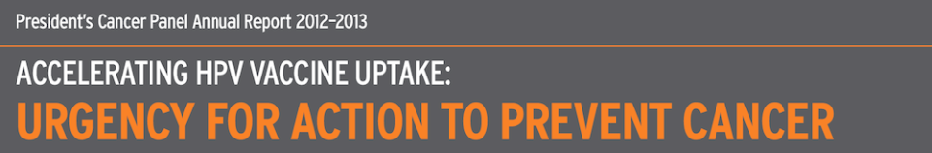
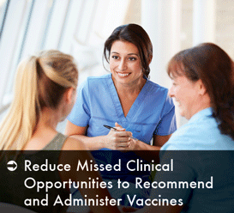
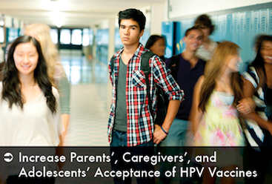
http://shar.es/TzFxv
Notes:
The President’s Cancer Panel is a group of three individuals including scientists and physicians who bring together stakeholders to develop plans related to preventing and reducing cancer morbidity and mortality.
In 2012-2013, to energize efforts to reach the HPV vaccines' potential to save lives, the President's Cancer Panel aimed to develop a multipronged strategy to accelerate vaccine uptake in the United States and globally. By supporting HPV vaccination as an urgent national and global health priority, the U.S. National Cancer Program has an unprecedented opportunity to contribute to preventing millions of avoidable cancers and other conditions in men and women worldwide.
The President's Cancer Panel finds underuse of HPV vaccines a serious but correctable threat to progress against cancer. In this report, the Panel presents four goals to increase HPV vaccine uptake; three of these focus on the United States:
Reduce Missed Clinical Opportunities to Recommend and Administer HPV Vaccines
Increase Parents', Caregivers', and Adolescents' Acceptance of HPV Vaccines
Maximize Access to HPV Vaccination Services

Slide 43
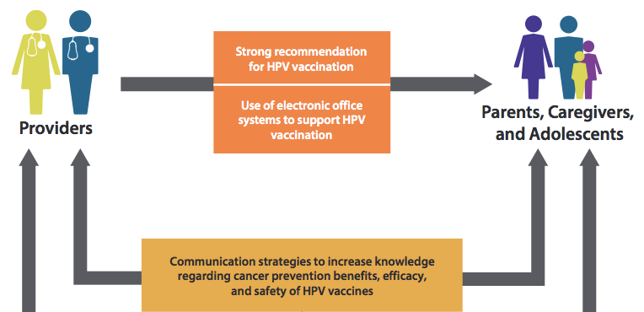

Slide 44
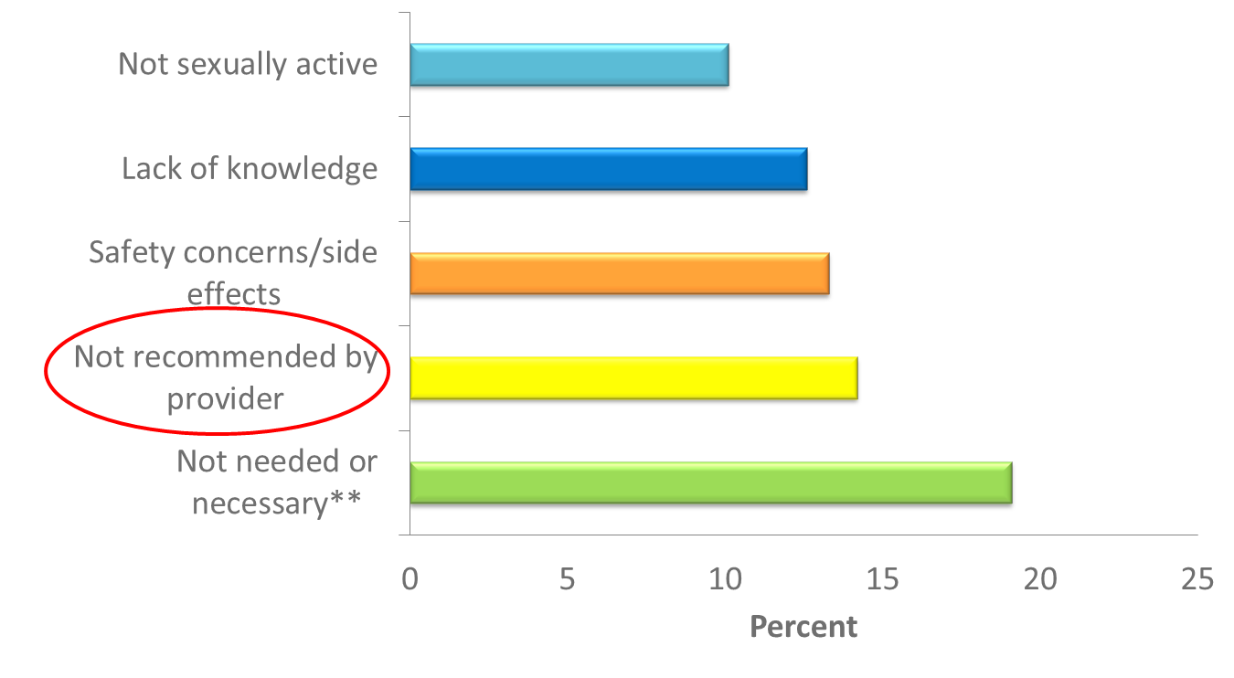
Some clinicians don’t provide a recommendation for HPV vaccine
* Not mutually exclusive.
** Did not know much about HPV or HPV vaccine.
National and State Vaccination Coverage Among Adolescents Aged 13–17 Years — United States, 2012
MMWR 2013; 62(34);685-693.
Notes:
This slide shows the responses that parents gave when asked why they would not be getting the HPV vaccine for their daughter in the next year.
Three reasons that parents provided—lack of knowledge, not needed, and not sexually active—all demonstrate a lack of understanding on the part of the parent, especially why it is important to vaccinate at ages 11 or 12. Parents need to be told that HPV vaccine is cancer prevention and that it must be given prior to exposure.
Safety concerns can be allievated by sharing the tremendous amount of data before and after the vaccine was licensed that demonstrate that HPV vaccine is safe.

Slide 45
Many providers underestimate the value parents place on HPV vaccine
Adapted from Healy et al. Vaccine. 2014;32:579-584.

Slide 46
How much information have you looked for on HPV vaccine?
 | None | A little | Some | Pretty much | A lot
Got/will get | 29.7% | 18.8% | 33.9% | 12.0% | 5.7%
Will not get | 50.0% | 19.5% | 18.6% | 4.2% | 7.6%
Unsure | 41.9% | 26.5% | 19.1% | 8.8% | 3.7%
Don’t know | 75.2% | 14.4% | 9.8% | 0.7% | 0.0%

Slide 47
Which of these best describes the advice your youngest adolescent’s doctor gave you regarding HPV vaccine?
 | Strongly rec’d against it | Rec’d against it | Talked about it but did not offer a rec | Rec’d it | Strongly rec’d it | Did not discuss it
Got/will get | 3.7% | 1.1% | 11.8% | 36.4% | 33.7% | 13.4%
Will not get | 5.9% | 5.1% | 21.2% | 15.3% | 7.6% | 44.9%
Unsure | 0.0% | 1.5% | 15.7% | 20.9% | 8.2% | 53.7%
Don’t know | 2.0% | 0.7% | 8.5% | 19.6% | 5.2% | 64.1%
Notes:
Assessing the Current State of Immunization Attitudes among Parents of Adolescents: Results from the 2012 SummerStyles (HealthStyles) Survey

Slide 48
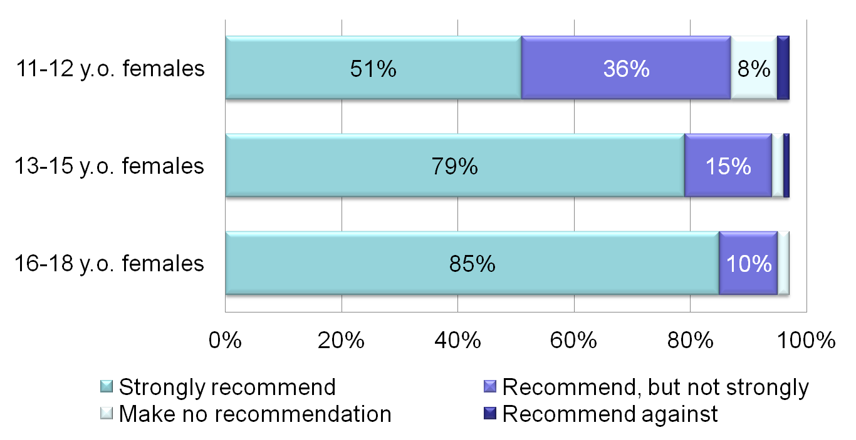
Most clinicians wait too long to make strong recommendations for HPV vaccine
Allison et al. https://cdc.confex.com/cdc/nic2011/webprogram/Paper25181.html
Notes:
When we have studied HPV vaccination practices among physicians we see that providers are less likely to recommend the HPV vaccine to their younger adolescent patients. This slide shows results of a national survey of pediatricians and family physicians. Only 51% of providers strongly recommend HPV for their female patients 11 to 12 years old as shown by the top light blue bar. And the percent who strongly recommend the vaccine increases with patient age.

Slide 49
Avoiding Missed Opportunities
HPV vaccine can safely be given at the same time as the other recommended adolescent vaccines
HPV vaccine can be provided during routine sports or camp physicals
Review immunization record even at sick/acute care visits
Encourage parents to keep accurate vaccination records and to review the immunization schedule
Notes:
There are many ways to avoid these missed opportunities.

Slide 50
Reduce Missed Clinical Opportunities to Recommend and Administer HPV Vaccines
Objective 1.3:
  Healthcare organizations and practices should use electronic office systems, including EHRs and IIS, to avoid missed opportunities for HPV vaccination.
Notes:
The key to increasing HPV vaccination in the U.S. is reducing missed clinical opportunities. If all providers strongly recommend HPV vaccines to age-eligible patients, including those receiving other vaccines, uptake of HPV vaccines should increase dramatically. Systems changes should be made, as necessary, to support this recommendation. Also, parents and adolescents should be provided with information about HPV-associated diseases and vaccines so they can make informed decisions. In addition, they should be able to obtain vaccines at convenient locations and from a wider range of providers, including pharmacists.

Slide 51
Evidence-based strategies to improve vaccination coverage
Reminder/recall system
  Provider level (e.g., EMR prompts)
  Parent/patient level (e.g., postcards, telephone calls, text messaging)
Standing orders
Provider assessment and feedback
  Assessment of vaccination coverage levels within the practice and discussion of strategies to improve vaccine delivery
Utilizing immunization information systems
www.thecommunityguide.org/vaccines/universally/index.html

Slide 52
Impact of Reminder/Recall on Vaccination
Rates among Adolescents
*p<0.05
Percent
Vaccine
Suh C et al. Pediatrics 2012;129:e1437-45

Slide 53
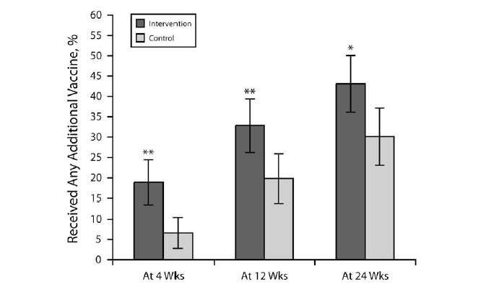
Percentages of adolescents 11-18 years of age who received any vaccination at 4, 12, and 24 weeks:
Text4Health-Adolescents, New York City, 2009
Stockwell et al. AJPH. 2012;102:e15-e21.

Slide 54
AFIX: Quality Improvement
Assessment
AFIX
Incentives
eXchange
Feedback
Notes:
AFIX is a quality improvement program used by awardees to raise immunization coverage levels, reduce missed opportunities to vaccinate, and improve standards of practices at the provider level. The acronym for this four-part dynamic strategy stands for
1.Assessment of the healthcare provider's vaccination coverage levels and immunization practices.
2.Feedback of results to the provider along with recommended quality improvement strategies to improve processes, immunization practices, and coverage levels.
3.Incentives to recognize and reward improved performance.
4.eXchange of information with providers to follow up on their progress towards quality improvement in immunization services and improvement in immunization coverage levels.

Slide 55
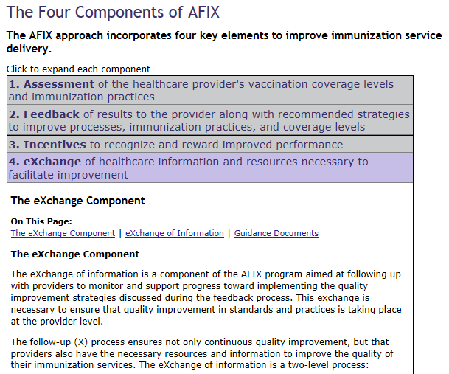
cdc.gov/vaccines/programs/afix/components.html

Slide 56
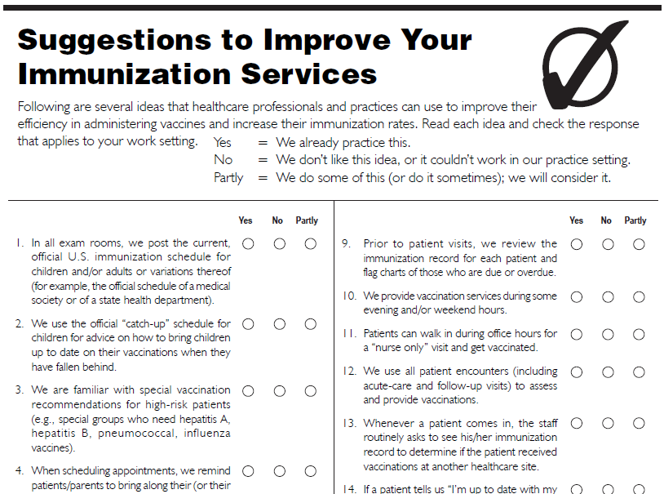
AFIX
cdc.gov/vaccines/programs/afix/index.html

Slide 57
Communication Tools
Resources for HPV vaccine communication campaigns

Slide 58
Increase Parents', Caregivers', and Adolescents' Acceptance of HPV Vaccines
Objective 2.1:
  CDC should develop, test, and collaborate with partner organizations to deploy integrated, comprehensive communication strategies directed at parents and other caregivers, and also at adolescents.

Slide 59
HPV Vaccine Communications:
Healthcare Professionals/Clinicians
Based on CDC research, communications to healthcare professionals/clinicians should emphasize:
All HPV cancers and indications for HPV vaccination
Need for strong recommendations to parents about vaccinating their kids at 11 or 12
Systems that can improve practice vaccination rates
Notes:
Based on these finding we created goals for healthcare professionals that include more knowledge on the cancers caused by HPV and the cancers prevented by HPV vaccine, also giving a strong recommendation for receiving HPV vaccine at the recommended ages.

Slide 60
HPV Vaccine Communications:
Parents
Based on CDC research, HPV vaccine communications for parents should emphasize:
HPV vaccine is CANCER PREVENTION
HPV vaccine is best at 11 or 12 years old
Importance of getting all recommended doses

Slide 61
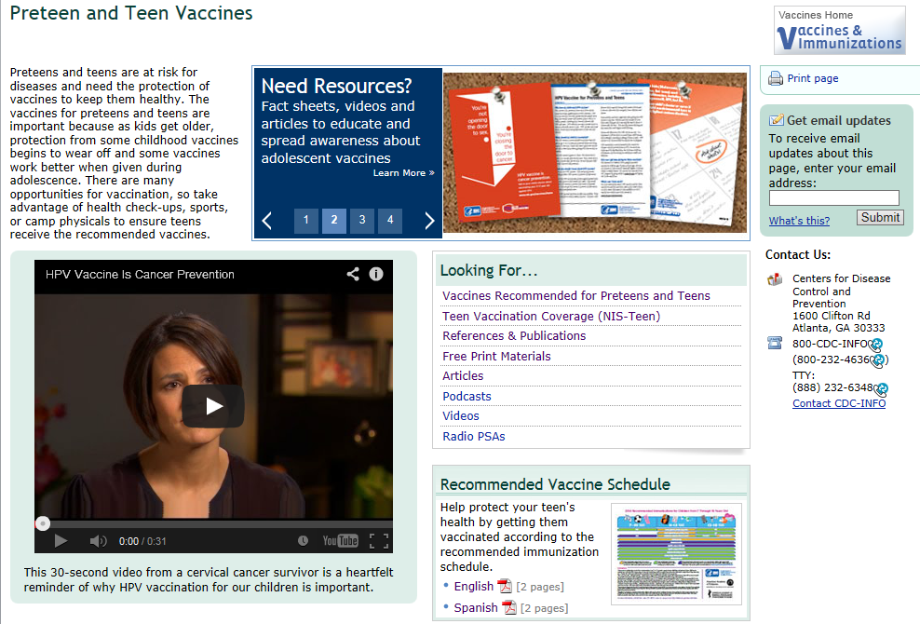
Vaccines for Preteens and Teens Website
cdc.gov/vaccines/teens

Slide 62
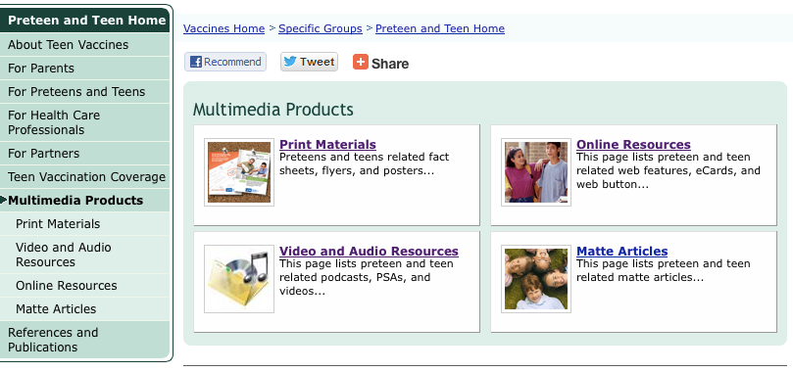
Communication Products and Tools
cdc.gov/vaccines/who/teens/products/index.html

Slide 63
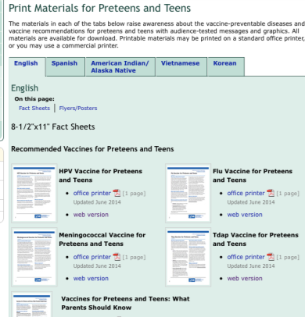
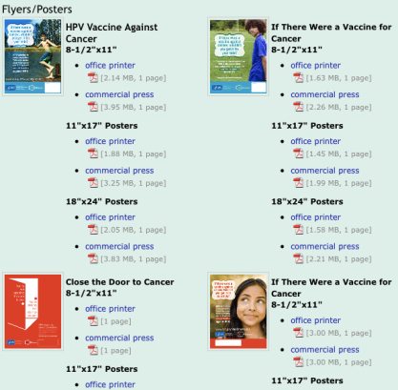
Print Materials
www.cdc.gov/vaccines/who/teens/products/print-materials.html

Slide 64
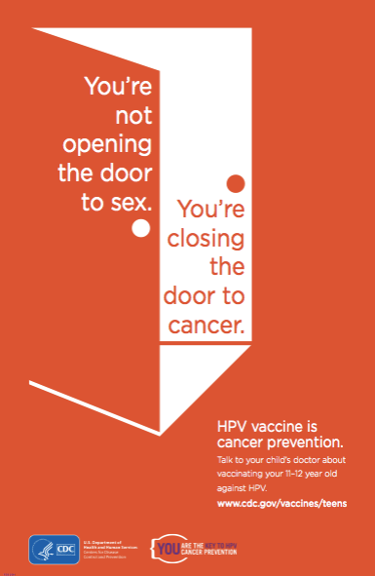
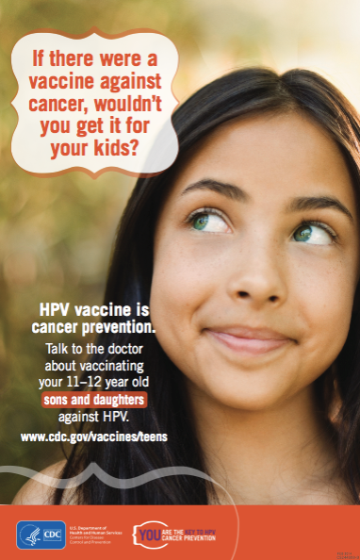

Slide 65
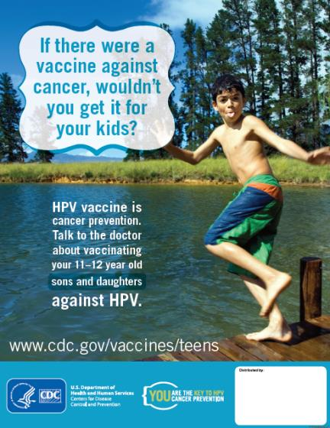
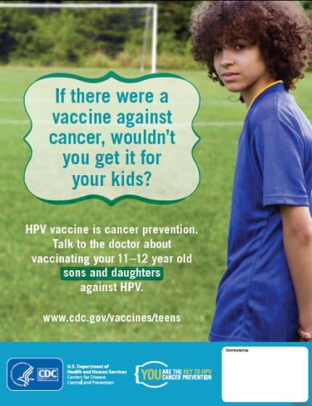

Slide 66
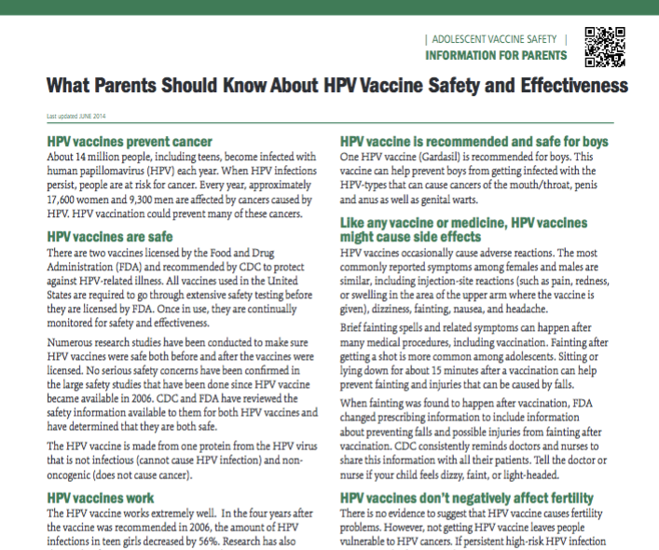
www.cdc.gov/vaccines/who/teens/vaccines/vaccine-safety.pdf
Notes:
http://www.cdc.gov/vaccines/who/teens/vaccines/vaccine-safety.pdf

Slide 67
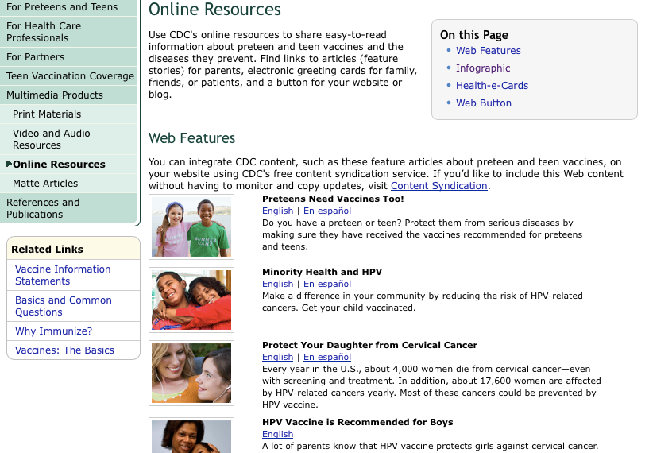
Online Resources
www.cdc.gov/vaccines/who/teens/products/web.html

Slide 68
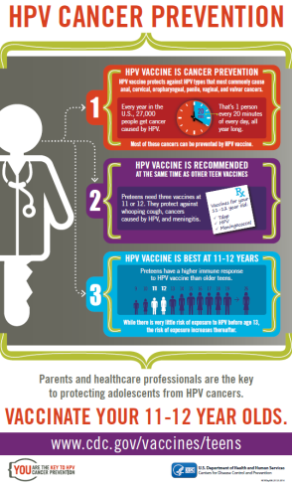
Online Resources: Infographic
www.cdc.gov/vaccines/who/teens/infographic/hpv-cancer-prevention.html

Slide 69
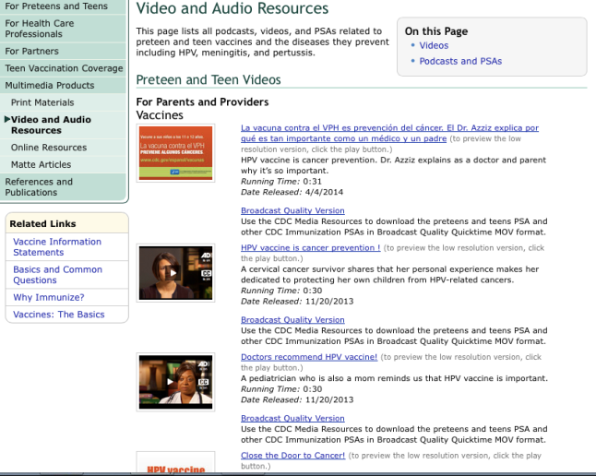
Video and Audio Resources
www.cdc.gov/vaccines/who/teens/products/video-audio.html

Slide 70
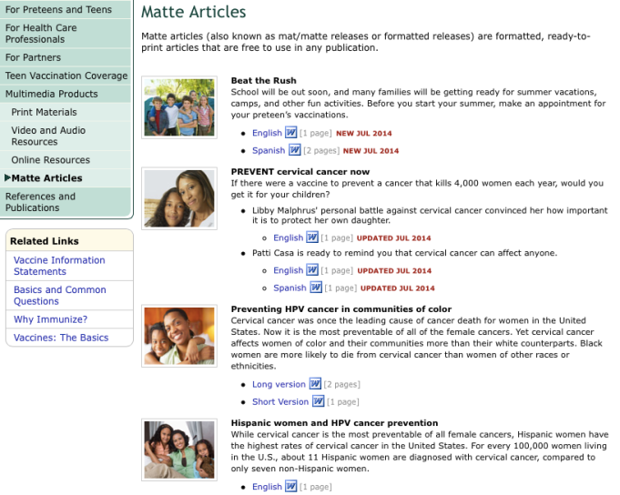
Matte Articles
www.cdc.gov/vaccines/who/teens/products/matte.html

Slide 71
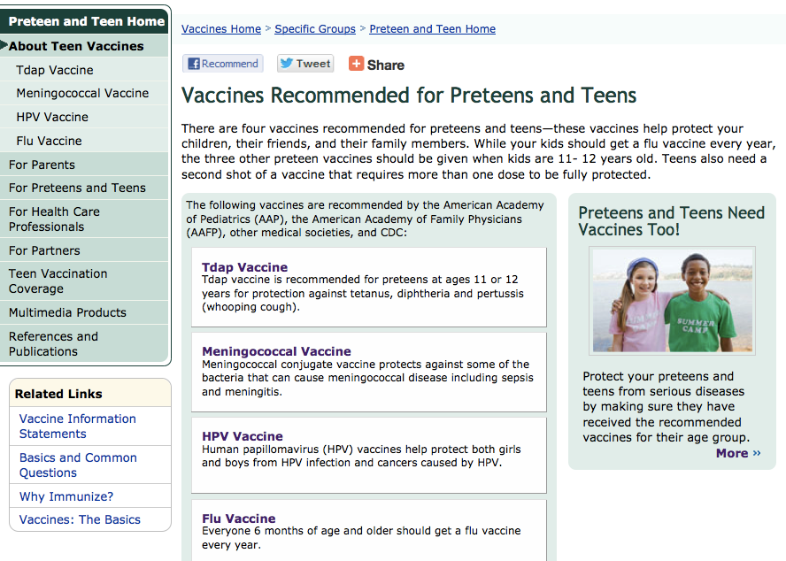
www.cdc.gov/vaccines/who/teens/vaccines/index.html

Slide 72
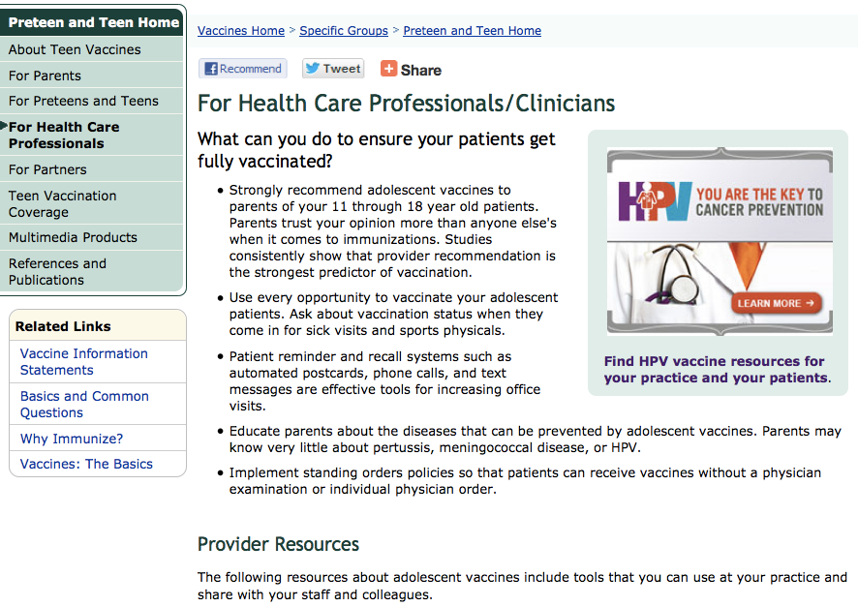
http://www.cdc.gov/vaccines/who/teens/for-hcp.html

Slide 73
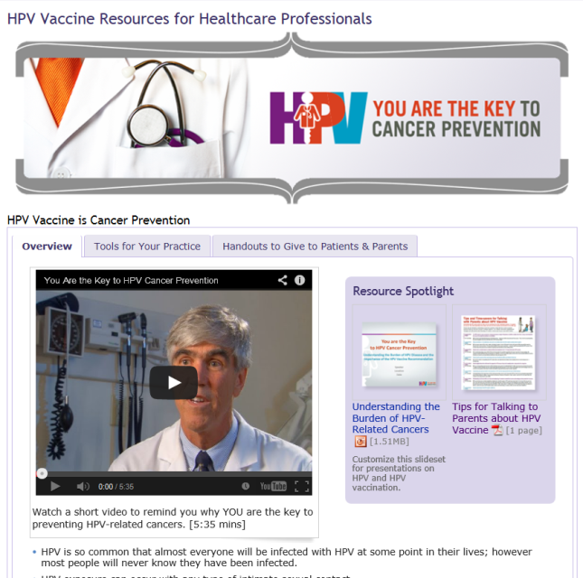
cdc.gov/vaccines/YouAreTheKey
Notes:
CDC launched a new website for healthcare professionals so everything about HPV vaccination is easily found in one place. The website is easy to navigate; it only has one page and three tabs. The first tab is the one you see here- the overview. I encourage you to watch the 5 minute video that was designed for healthcare professionals.

Slide 74
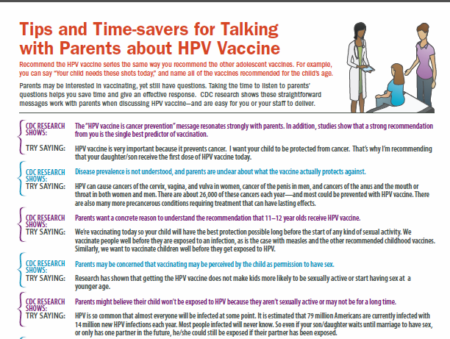
Tips for Talking to Parents about
HPV Vaccine
Tools for your Practice
cdc.gov/vaccines/hpv-tipsheet
Notes:
This tip sheet, which is currently in the spotlight section on the overview tab, can also be found within the Tools for Your Practice tab. This tab also includes links to CDC Expert Commentaries on Medscape, free CME courses, the pink book, and other tools and information specifically designed for healthcare professionals.

Slide 75
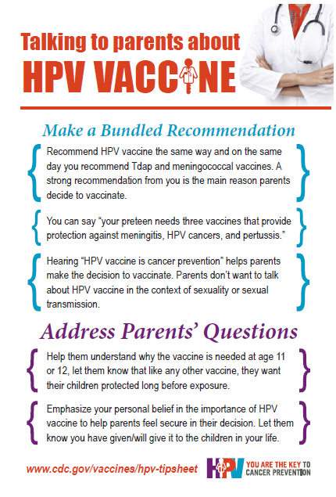
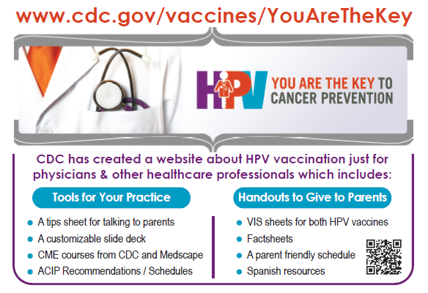
Notes:
Mini version of the tipsheet to hand to clinicians

Slide 76
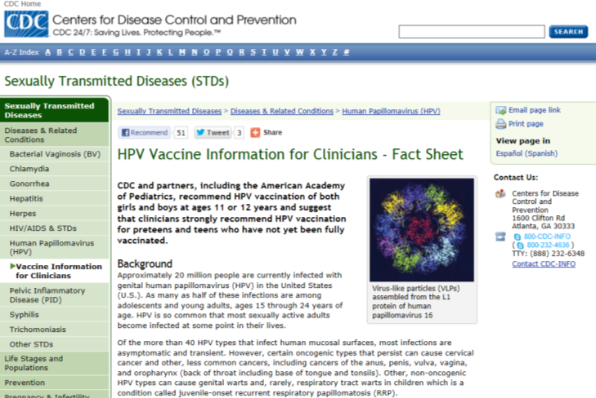
HPV Fact Sheet for Clinicians
Tools for your Practice
cdc.gov/vaccines/who/teens/for-hcp/hpv-resources.html
Notes:
This factsheet on HPV vaccine for clinicians is another example of a Tool for Your Practice.

Slide 77
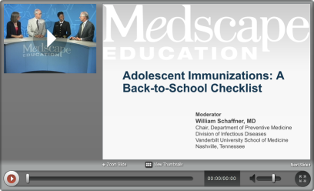
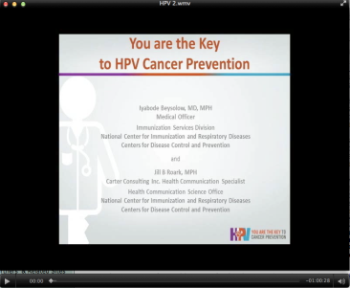
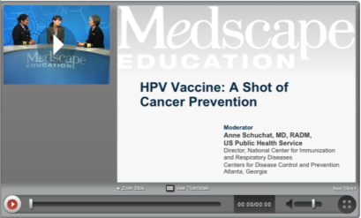
Continuing Education
Tools for your Practice
cdc.gov/vaccines/who/teens/for-hcp/hpv-resources.html
Notes:
This CME available at no cost on Medscape. The link can be found on the Tools for Your Practice tab.

Slide 78
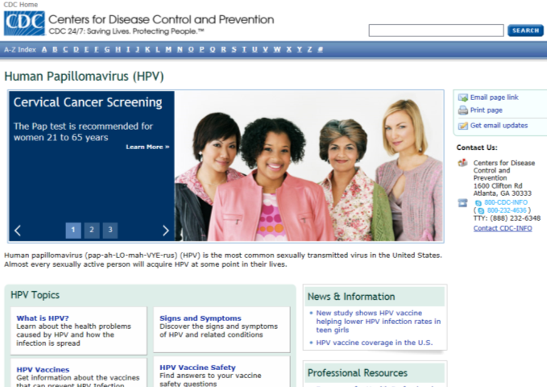
HPV Portal
Tools for your Practice
cdc.gov/vaccines/who/teens/for-hcp/hpv-resources.html
Notes:
This is another tool- CDC’s HPV portal which has information for both clincians and the general public.

Slide 79
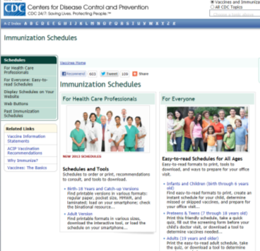


Immunization Schedules, Recommendations, and more
Tools for your Practice
cdc.gov/vaccines/who/teens/for-hcp/hpv-resources.html

Slide 80



Patient and Parent Handouts
Resources for Patients
cdc.gov/vaccines/who/teens/products/print-materials.html

Slide 81

Adolescent Immunization Schedule
Resources for Patients
cdc.gov/vaccines/schedules/easy-to-read/preteen-teen.html

Slide 82


HPV Vaccine Information Sheets
Resources for Patients
cdc.gov/vaccines/hcp/vis/

Slide 83



HPV Vaccine Resources in Spanish
Resources for Patients
cdc.gov/spanish/inmunizacion/index.html

Slide 84
Suggested activites
State and local programs to improve HPV vaccine coverage

Slide 85
Use data to drive decision-making
RECOMMENDED ACTIVITIES
Consider what disparities exist and what can be done to improve coverage
AFIX and ordering data can determine which clinicians/practices/clinics need the most assistance
State-level data on Tdap and HPV vaccine coverage can highlight missed opportunities

Slide 86
How State and Local Immunization Programs Can Improve HPV Vaccination Rates
Adolescent vaccination is a priority
Having an adolescent coordinator helps
Strong partnerships with provider community
  Professional organizations
  VFC providers
Incorporate promotion of adolescent vaccination into existing activities
  Conduct adolescent AFIX
  Reminder/recall
  Incorporate HPV vaccination into existing visits for school required vaccines
Routinely evaluate data and use data for action

Slide 87
Work with partner organizations to advocate for HPV vaccination
RECOMMENDED ACTIVITIES
State and local AAP and AAFP chapters
Cancer coalitions/alliances/organizations
American Cancer Society chapters

Slide 88







Partnership Development
Notes:
Campaign partnerships provide
Expansion digital and social media presence of communication messages
Reaching people where they already are
Helping clinicians talk about HPV vaccine and make strong recommendations
Guiding parents to accurate and credible sources of information
Audience research gave insight to new partnership opportunities
Moms wanted to hear that oncologists support HPV vaccination  partnership with Society of Gynecologic Oncology and Foundation for Women’s Cancer

Slide 89
What your partners can do:
SYNDICATE content to their website
    http://tools.cdc.gov/syndication/
    http://www.cdc.gov/vaccines/who/teens/products/web-button.html
DOWNLOAD a matte article for publications
    http://www.cdc.gov/vaccines/who/teens/products/matte.html
SHARE factsheets with parents & clinicians
    http://www.cdc.gov/vaccines/who/teens/products/print-materials.html
    http://wwwn.cdc.gov/pubs/ncird.aspx
COLLABORATE to increase the campaign reach

Slide 90
For example
HPV Vaccination Improvement Activities

Slide 91


Slide 92
Minnesota Cancer Alliance and State Immunization Program Partnership
Minnesota Cancer Alliance Strategy:
  HPV Vaccine added to Cancer Plan 2011-2016
  HPV Vaccine was added to the Policy Agenda (2011)
  HPV was identified as an MCA Steering Committee priority 2011/12
Work plan aimed at changing the message around HPV
  Moving away from HPV as an STD and framing the conversation around HPV vaccine as cancer prevention
Strategy includes recruiting physicians to:
  Write editorials in provider publications
  Host provider education webinars
  Conduct clinic visits

Slide 93

Joint letter from Minnesota Cancer Alliance and Minnesota Department of Health
Sent to 253 clinics identified via VFC ordering records

Slide 94


Slide 95


Slide 96



Chicago – Parent Focused

Slide 97


Kansas: Posters –> Postcards

Slide 98



Iowa – Provider Focused

Slide 99


Slide 100
#WeCanStopHPV
HPV Vaccine is Cancer Prevention
For more information, visit:
cdc.gov/vaccines/YouAreTheKey
Email questions or comments to
CDC Vaccines for Preteens and Teens:
PreteenVaccines@cdc.gov
Jill can be reached at:
JRoark@cdc.gov
The findings and conclusions in this report are those of the authors and do not necessarily represent the official position of the Centers for Disease Control and Prevention.

